Slide 1
PM 420 Office Hours
Being a Leader

Slide 2
PM 400 - MS Project & Communication
Welcome Class
Questions?
  Any questions related to past assignments, or class in-general?
Team / Group Assignments
Mini-Lecture
  Risk Identification Templates & Process
    Risk Identification Questionnaire
    Risk Management Plan Template
    Risk Assessment
    Log File
  “Communications & Conflict” with Maslow, SCARF, and Fierce Conversations
Questions & Wrap-up
Week 6
Notes:
Record the session!

Slide 3
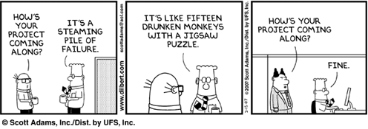
Project Management is 90% Communication

Slide 4
Become a Friendlier Person
Don’t criticize, condemn, or complain.
Give honest, sincere appreciation.
Arouse in the other person an eager want.
Become genuinely interested in other people.
Smile.
Principles from
How to Win Friends and Influence People

Slide 5
Become a Friendlier Person
Remember that a person’s name is to that person the sweetest and most important sound in any language.
Be a good listener. Encourage others to talk about themselves.
Talk in terms of the other person’s interests.
Make the other person feel important – and do it sincerely.
Principles from
How to Win Friends and Influence People

Slide 6
Gain Cooperation
Win People to Your Way of Thinking
The only way to get the best of an argument is to avoid it.
Show respect for the other person’s opinion. Never say, “You’re wrong.”
If you’re wrong, admit it quickly and emphatically.
Begin in a friendly way.
Get the other person saying “yes, yes” immediately.
Let the other person do a great deal of the talking.
Principles from
How to Win Friends and Influence People

Slide 7
Gain Cooperation
Let the other person feel the idea is hers.
Try honestly to see things from the other person’s point of view.
Be sympathetic with the other person’s ideas and desires.
Appeal to nobler motives.
Dramatize your ideas.
Throw down a challenge.
Principles from
How to Win Friends and Influence People

Slide 8
Real World Application:
What are common themes among these behaviors?
When have you used one of these principles at work?
What response and result did you get?

Slide 9
Expressing Positive Feedback
What strength do I like, admire, or respect in this person (trait, quality, characteristic, value)?
What evidence do I have?

Slide 10
PM 420 - MS Project & Communication
Happy Valentines Day ☺
Questions?
Team / Group Assignments
  Feedback on Schedule assignment 7a
  Week 6 Decision Tree – six not submitted
  Walk Through Provided material on Canvas
Mini-Lecture
  Continued - “Communications & Conflict” with Maslow, SCARF, and Fierce Conversations
Questions & Wrap-up
Week 6
Notes:
Record the session!

Slide 11
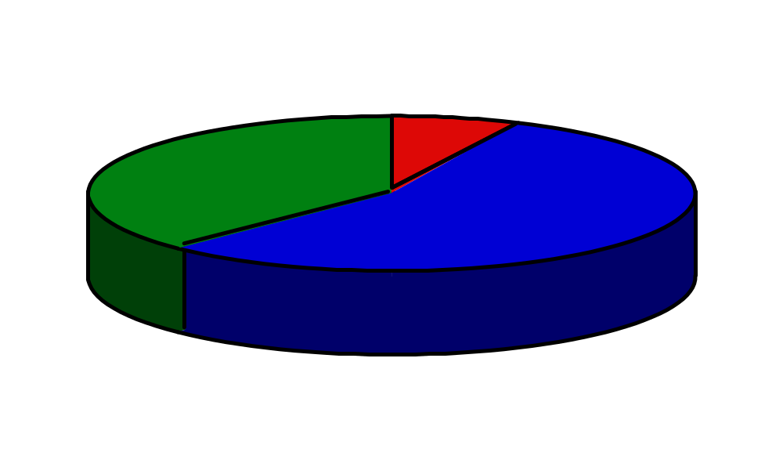
Communication When Incongruent...
Words
7%
Sound of Voice
38%
Look/Act
55%
Dr. Albert Mehrabian, UCLA Professor
10 year study of non-verbal communication

Slide 12
Barriers to Good Listening
Distractions
Time
Interest
Pre-conceived ideas
Other Ideas?
Notes:
Distractions:
Work needing to get done
Phone ringing
People walking by
Time:
Time of day - morning or afternoon person
Another meeting set for after this one
Interest:
You just don’t care about the topic
Pre-conceived ideas
You already know the answer
You already know what you want to do

Slide 13
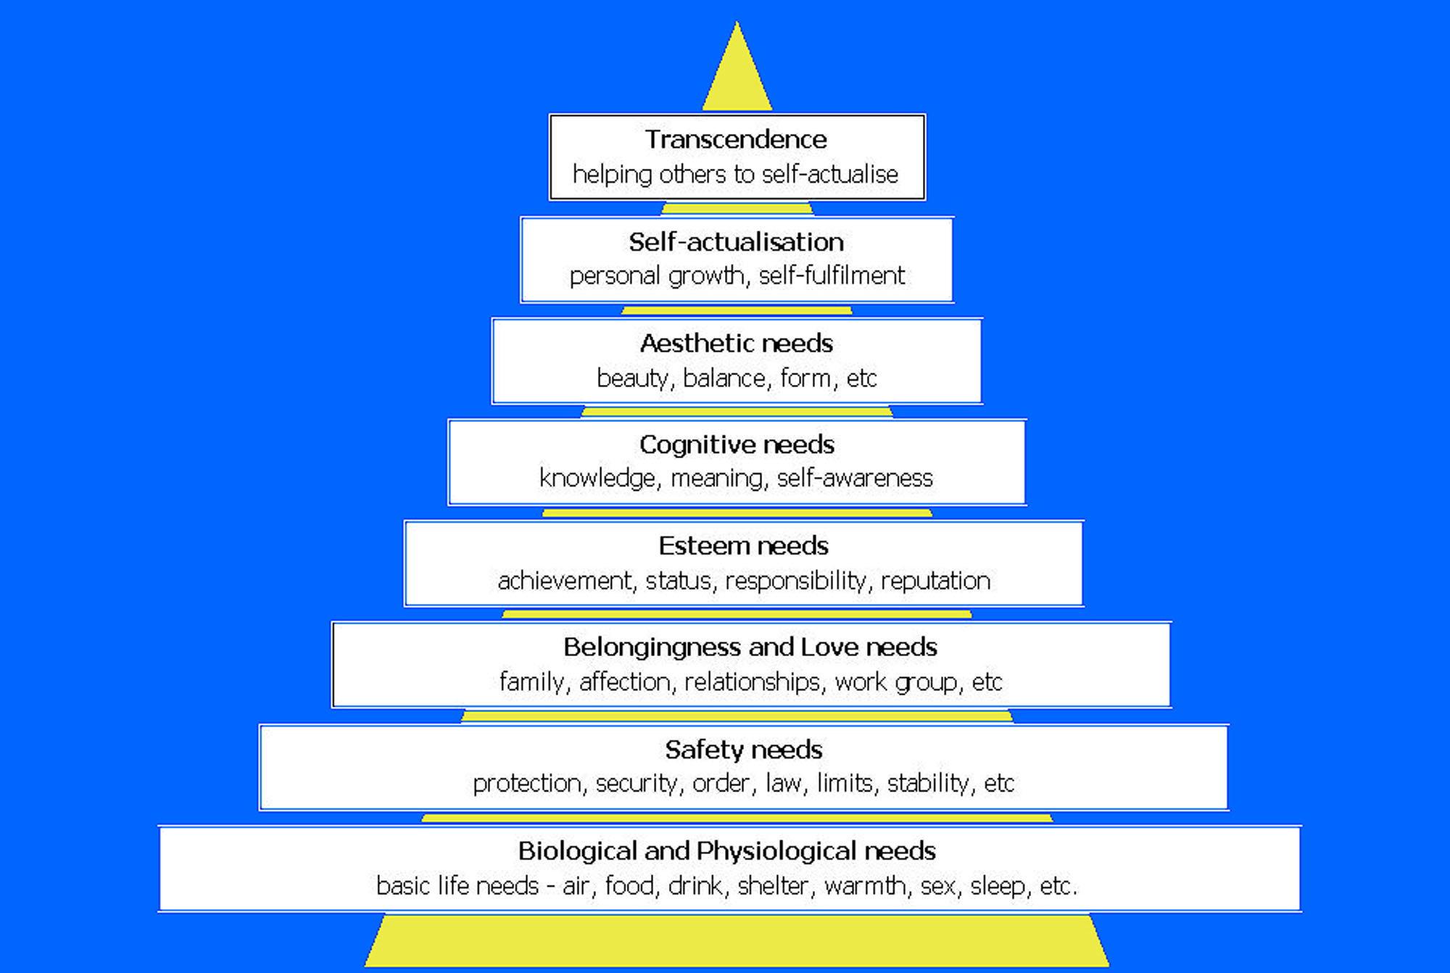
Maslow Hierarchy of Need

Slide 14
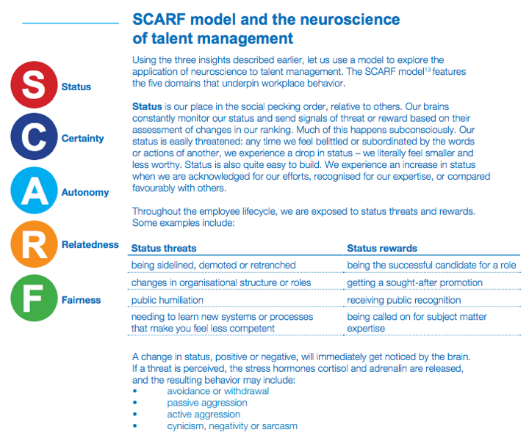
Maslow is correct ? What about SCARF ?
http://dcb9maxnxelio.cloudfront.net/wp-content/uploads/2012/06/The-Neuroscience-of-Talent-Management-White-Paper.pdf

Slide 15
Steps to Good Listening
Genuinely greet the person
Be quiet and don’t interrupt
Maintain eye contact
Ask short, clarifying questions
Occasionally briefly restate what has been said
Pay attention to your body language
Summarize and agree
Notes:
Answer: C

Slide 16

About the Seminar
One-day seminar taught by Susan Scott of Fierce, Inc.
Offered as part of the Starbucks/IMS relationship
Other resources available: Susan’s book, webinars, fierceinc.com, etc.
This deck is an intro to the concepts in hopes that you will pursue the book and/or the seminar

Slide 17
What is a conversation?
Exchange of words, thoughts, ideas, and feelings with someone else. If the communication is one way, it is a “versation”. Not effective.

Slide 18
Transformational Idea 1
Our careers, companies, personal relationships, our very lives, succeed or fail gradually, then suddenly, one conversation at a time.
Failed or missing conversations cause ultimate failure. An effective leader turns his/her attention to the conversations going on.
A fierce conversation: One in which we come out from behind ourselves and make it real. It can be uncomfortable. Unreal conversations can be expensive because you don’t find out what’s really going on. This can be costly.

Slide 19
Transformational Idea 2
The conversation is the relationship
If we don’t have the conversation, we are making the relationship smaller.
Human beings make decisions first for emotional reasons, then for rational reasons. The challenge of the organization is to engage their employees beyond paycheck and engage the emotional level. It becomes a sustainable competitive edge.

Slide 20
Transformational Idea 3
All conversations are with myself and sometimes involve other people.
We interpret everything through our own contexts. It’s the invisible filter through which I comprehend everything – my values, beliefs, and opinions (essentially, my “truths”). Once someone falls outside my belief system just once, they lose their ability to influence me. It is difficult to regain.

Slide 21
7 Principles
Master the Courage to Interrogate Reality
Come Out From Behind Yourself, Into the Conversation, and Make It Real
Be Here, Prepared to Be Nowhere Else
Tackle Your Toughest Challenge Today
Obey Your Instincts
Take Responsibility For Your Emotional Wake
Let Silence Do the Heavy Lifting

Slide 22
Fuel for Fierce Conversations
Sampling of questions that help the conversation:
What is the most important thing we should be talking about today?
What topic are you hoping I won’t bring up?
What’s the highest leverage use of your time right now? Are you doing it?
If you were hired to consult with our company, what would you advise?
If you were competing against our company, what would you do?
What threatens your peace? What threatens the business? Your personal health? Your fulfillment?

Slide 23
How Do I Listen?
How
Do I
Listen to others?
As if everyone were my Master
Speaking to me
His
Cherished
Last
Words.
-Hafiz

Slide 24
Decision Tree
The decision tree is a tool for delegation, accountability and professional development. Direct outcomes of using a decision tree are: an individual’s development path is clear, their progress is acknowledged, and leaders are free to lead versus micro-manage.
Leaf Decision
Make the decision. Act on it. Do not report the action you took.
Branch Decision
Make the decision. Act on it. Report the action you took daily, weekly or monthly.
Trunk Decision
Make the decision. Report your decision before you take action.
Root Decision
These decisions are made by senior executives, with input from many people.

Slide 25
This Sane Idea
Let Your
Intelligence begin to rule
Whenever you sit with others
Using this sane idea:
Leave all your cocked guns in a field
Far from us,
One of those damn things
Might go
Off.
-Hafiz

Slide 26
Question & Answer
New questions?
Have a good week!
Week 6

